Slide 1
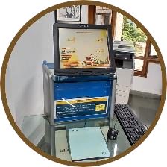
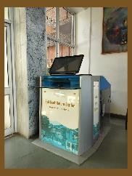
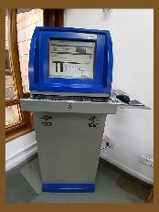
GANDHI SMRITI LIBRARY
Mussoorie
One of the most valuable assets of the Lal Bahadur Shastri National Academy of Administration is the Gandhi Smriti Library. Nearly 1.8 lakh documents on topics as diverse as public administration, international relations, economics, law, and the social sciences are held in the Library, which occupies the first and mezzanine level of the Karamshilla building.
COLLECTIONS AT A GLANCE: Books | 1,72,344 | COLLECTION OF SECTIONS: Gandhiana Section | 435
Bound volumes of Journals | 9,497 | Reference Section | 4105
Digital Books | 4,178 | Making of the Nation | 3125
Braille Books | 64 | Gyanlok Collection | 30,341
Magazines Journals | 64 69 | Hindi Section State Section | 25,150 16,319
Newspapers | 18 | Children Section | 3,260
E-Databases | 11
 |  | Fiction Section | 9,942
E-Journals | 34
 |  | Hon’ble President’s Collection | 281
Exclusive Talking Books for Children | 40
 |  | Hon’ble Prime Minister’s Collection | 452
“The Bhagvad Gita” Talking Book | 01
 |  | Jnanpith & Sahitya Akademi Gallery | 790
CD/DVDs | 8,496
 |  | Bharat Ratna Collection | 257
Audio/Video Cassettes | 3,817
 |  | Rabindranath Tagore Collection | 205
SELF ISSUE RETURN KIOSK:
The library is completely automated and RFID equipped. Users can issue and return books independently, User just sets the book(s) they wish to borrow on the RFID station, together with their membership card.
HOW TO SEARCH ABOUT LIBRARY:
Through LBSNAA Website-
www.lbsnaa.gov.in
Knowledge Resources
Gandhi Smriti Library
HOW TO SEARCH LIBRARY COLLECTION:
Through Gyan Portal- https://gy an.lbsnaa.gov.in
RFID book drops, are placed for returning the books at Karamshilla Building and another in the Gyanshilla Building reception area
OPAC: (Online Public Access Catalog)
Through OPAC- Online Public Access
Catalouge, Users can search by title, author, subject, call number, ISBN, ISSN,
Library
E- Library (My Loft)
Gandhi Smriti Library Online Catalouge (OPAC)
accession number, series etc.

Slide 2
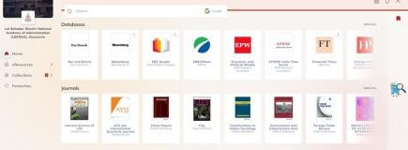
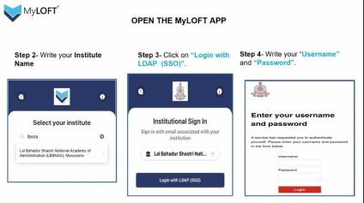
E-RESOURCES SUBSCRIBED BY THE LIBRARY:
It has a rich collection of digital content, that is placed in RemoteX portals and readily available for
the users within and outside the campus. E-resources (through Gyan portal; contains all e-
databases, various journals through MyLOFT (My library on finger tips). These resources are used by participant officers on various course assignments and dissertation work.
Law Databases:
SCC Online LiveLaw
Bar & Bench Manupatra EBC Reader
EBSCO Research Databases:
Business source complete
Political Science Complete EconLit with Full Text SocIndex with Full Tex
Statistical database:
Indiastat.com
EPWRF - India Time Series
Other database:
JSTOR online IndianJournals.com
Digital Newsstand Magzter (For digital Newspapers and Magazines). Steps to login
To log in Continue with your E-mail Address
Enter the OTP received in your mail & and verify
Note:
All databases & journals are access through IP based.
Supreme Court Cases (SCC Online): IP Based Unlimited Access: (New users need to click IP login >click register here and then give their e-mail & name & year. Registered users are required to click IP login >type their registered email ID > login now)
Magzter: IP access limited to 250 users / Email / OTP based: (The new users have to register their e-mail id; click
on “continue with e-mail address” > Enter email address and submit > An OTP is received in your mail. Please enter the OTP and verify to log in to the database)
Manupatra: IP Based Unlimited Access ; (Off-campus access restricted to single user licence, provided through ID & Password.
G A N D H I S M R I T I L I B R A R Y O N F I N G E R T I P S:
Access through LBSNAA Website: www.lbsnaa.gov. > Click Knowledge Resources > Gandhi Smriti Library > click elibrary MyLOFT (My library on Finger Tips)
or access through Gyan Portal: Click Library, then E-Library(MyLOFT)
A page prompting you to enter your username and password appears Please use your Sargam / Gyan Credentials to login
Click on "Add Extension" to install the Myloft Browser Extension (for activation of the account when using the app for the first time)
Choose"e-resources" to access the databases/ Journals/other resources etc.
How to sign in? For Mobile:
Search for the MyLoft app in Google Play (for Android 5 and above) or Apple App Store (for iOS 11 and above), Install and open
Type lbsnaa and select Lal Bahadur Shastri National Academy of Administration (LBSNAA)
Click "Login with LDAP (SSO)" and enter your Sargam/Gyan credentials on the screen displayed
Accept the request to add VPN config.
L IBRARY TIMINGS:
Working Days (During Courses) - 9.00 A.M. to 9.00 P.M. During Exams - 9.00 A.M. to 11.00 P.M. (on demand) Without Courses - 9.00 A.M. to 5.30 P.M.
Saturdays, Sundays & Holidays - 9.30 A.M. to 6.00 P.M.
For further assistance from library, please contact: Library Extn. No. 0135-222 -2336, 2334

